Slide 1
Malignant and Non-Malignant
By –SHARUKH ANSARI

Slide 2
Problem Statement
In this project we need to build a model which can detect that which comment is malignant or not
Now a days people uses social media to share everything but there is some people who used it for put abusive comment
The proliferation of social media enables people to express their opinions widely online. However, at the same time, this has resulted in the emergence of conflict and hate, making online environments uninviting for users. Although researchers have found that hate is a problem across multiple platforms, there is a lack of models for online hate detection.
So, we work on a project to build a model to predict Malignant comments.

Slide 3
Analysis
Data Analysis:
We need to clean data before building any model.
Removing punctuation, stop word and other pattern which do not hold any importance or meaning in documents
We need to check what words people frequently while posting comments.

Slide 4
Understanding
The data set contains the training set, which has approximately 1,59,000 samples and the test set which contains nearly 1,53,000 samples. All the data samples contain 8 fields which includes ‘Id’, ‘Comments’, ‘Malignant’, ‘Highly malignant’, ‘Rude’, ‘Threat’, ‘Abuse’ and ‘Loathe’.
Online hate, which is often referred to as abusive language, is a major threat to the stability of social media platforms. There are many factors that contribute to this behavior. The rise of online trolls and cyberbullying has been a distressing experience for many celebrities and influencers. It can lead to depression, self-hatred, and suicidal thoughts.
Our goal is to build a prototype of online hate and abuse comment classifier which can used to classify hate and offensive comments so that it can be controlled and restricted from spreading hatred and cyberbullying.

Slide 5
Exploratory data analysis
Importing the dataset:
Importing the dataset using the “read_csv()” function of the Pandas library. This function can read a CSV file (either locally or through a URL) and also perform various operations on it.
data_training = pd.read_csv(“train(in csv).csv")
data_testing = pd.read_csv(“test(in csv).csv")
Extracting the independent variable.
To extract the independent variables, we used drop function of the Pandas library.
X = Features
Here data_training is the data set which contains the independent and dependent variable i.e comment text and target column which is created by us.

Slide 6
Exploratory data analysis
Dataset cleaning
In this dataset we need to first clean all the documents so that we can reduce the size of the no. of features and make our data more clean and understandable.
To clean the dataset we have used regex exp to remove punctuation, numbers, email id, and extra spaces between words but before removing any of this we need to convert all the documents into lower case
Stop words:- Stop words are those words which is present frequently but do not carry any information or importance so we also need to remove this from documents.
After cleaning the dataset we need to convert comments into vectors. I have used TF-IDF to convert comments into Vectors
Splitting the data:
x_train,x_test,y_train,y_test = train_test_split(X,Y,test_size = .30,random_state = 27)

Slide 7
Visualization

Slide 8
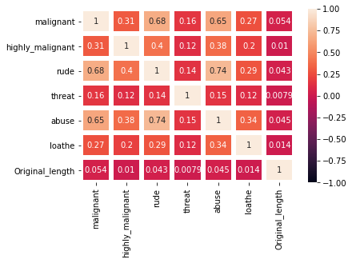
All the columns have seems to have multicollinearity issues

Slide 9
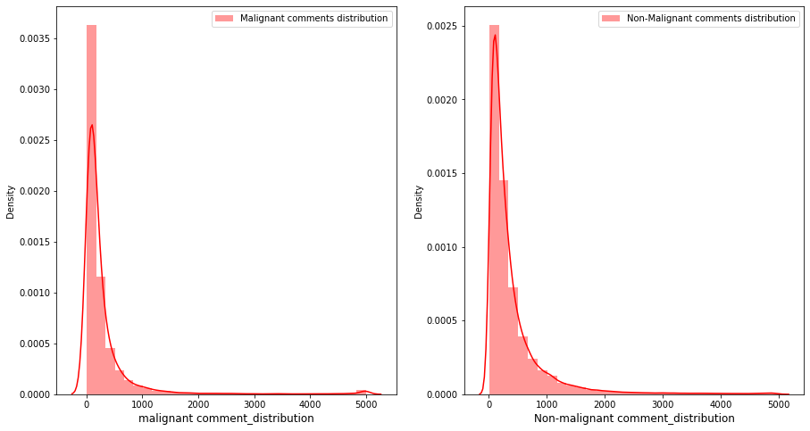
Data distribution before cleaning

Slide 10
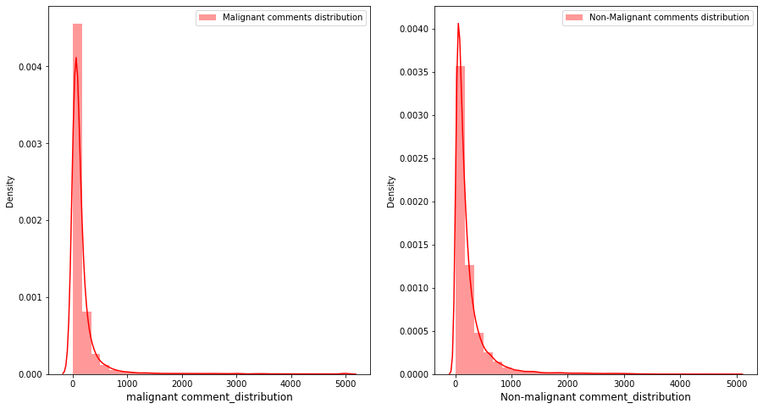
Data distribution After cleaning

Slide 11
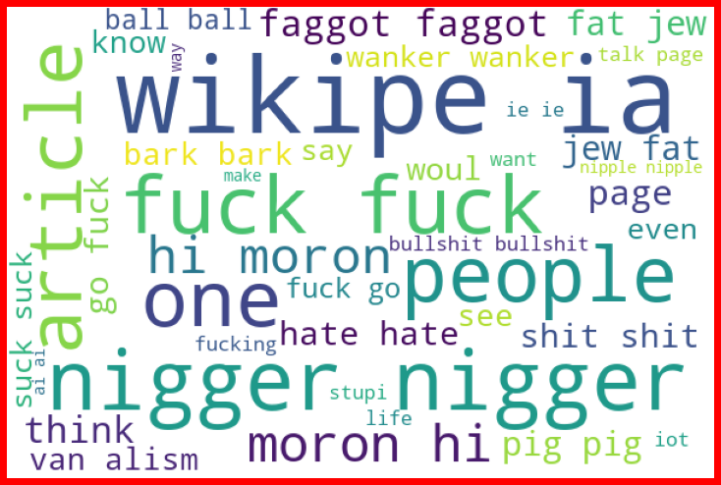
Frequents words used in malign comments

Slide 12
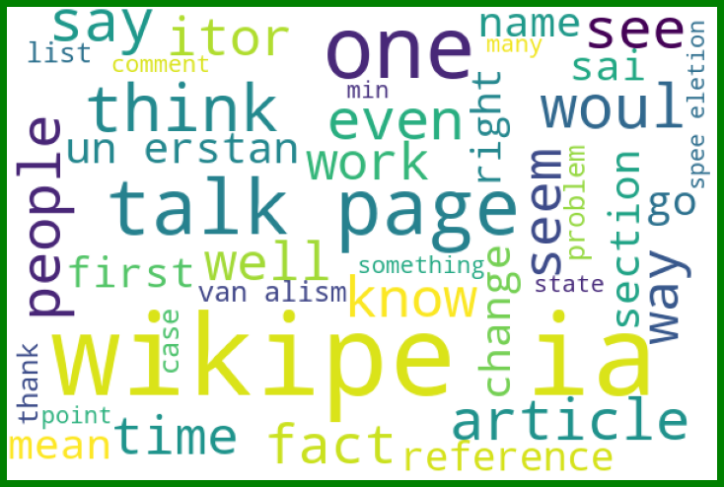
Frequent Words in non-malign comments

Slide 13
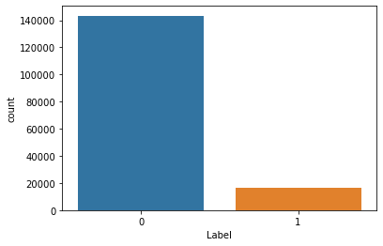
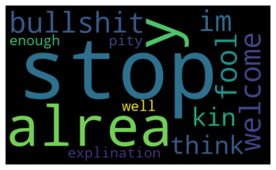
Target columns distribution
Frequent Words in Testing words

Slide 14
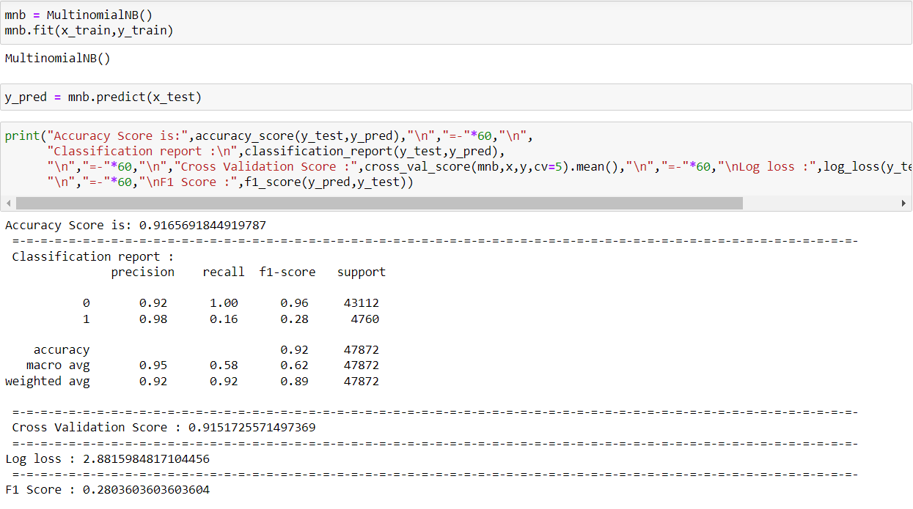
Model selection
MultinomialNB

Slide 15
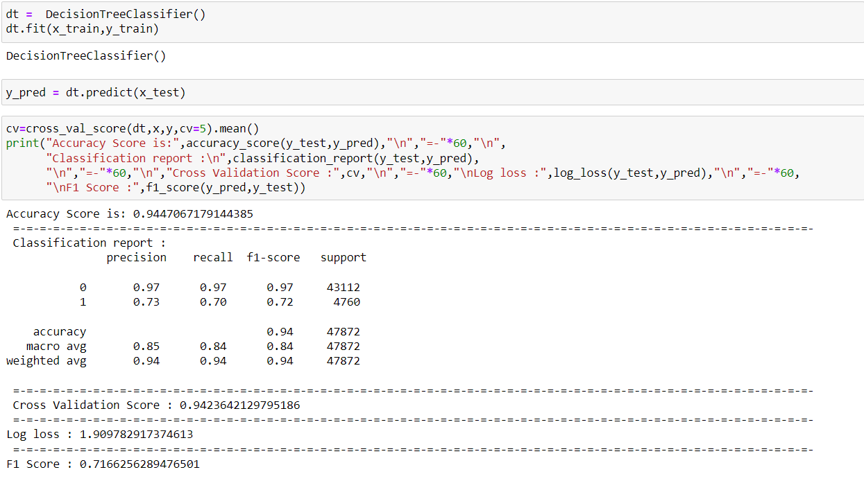
Model selection
Decision Tree classifier

Slide 16
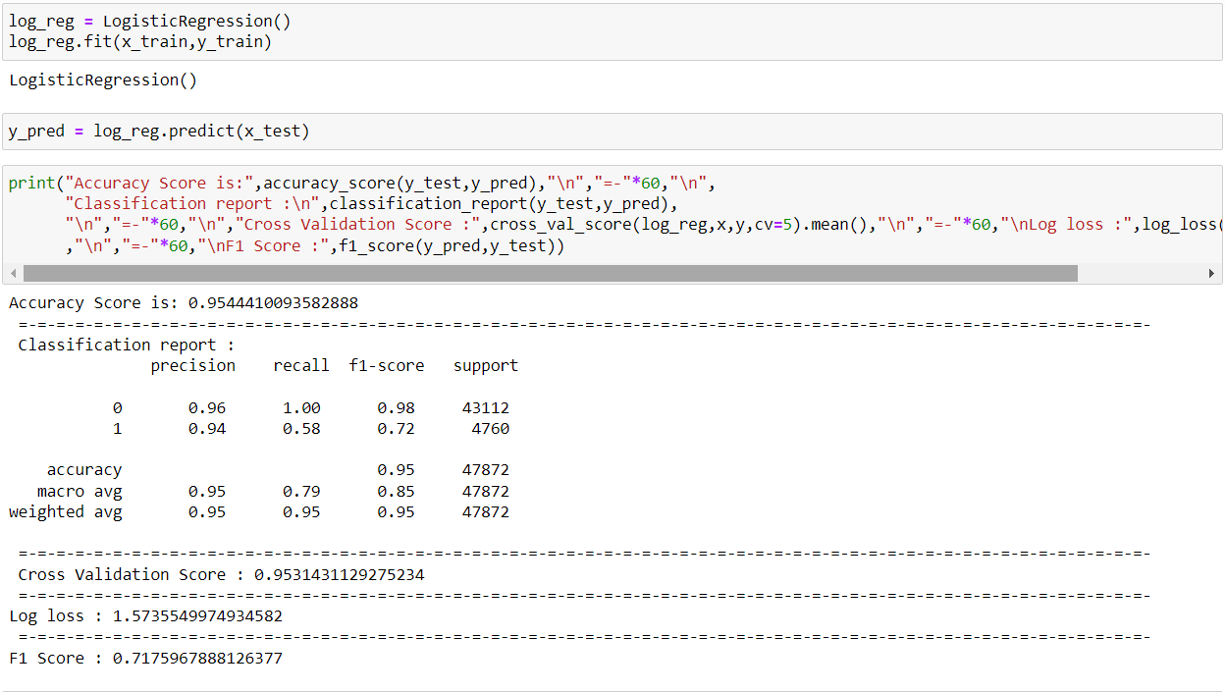
Model selection
Logistic Regression

Slide 17
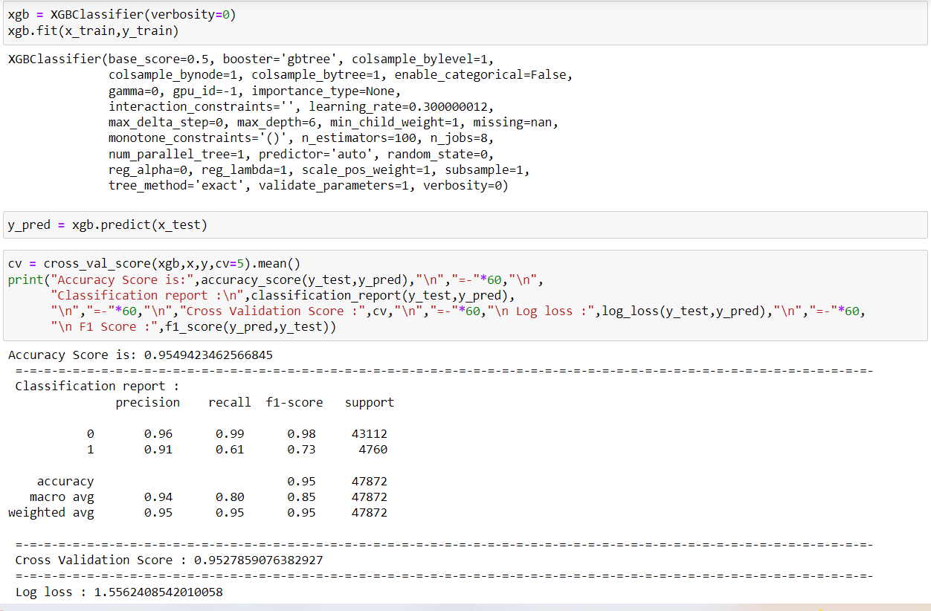
Model selection
XGB Classifier

Slide 18
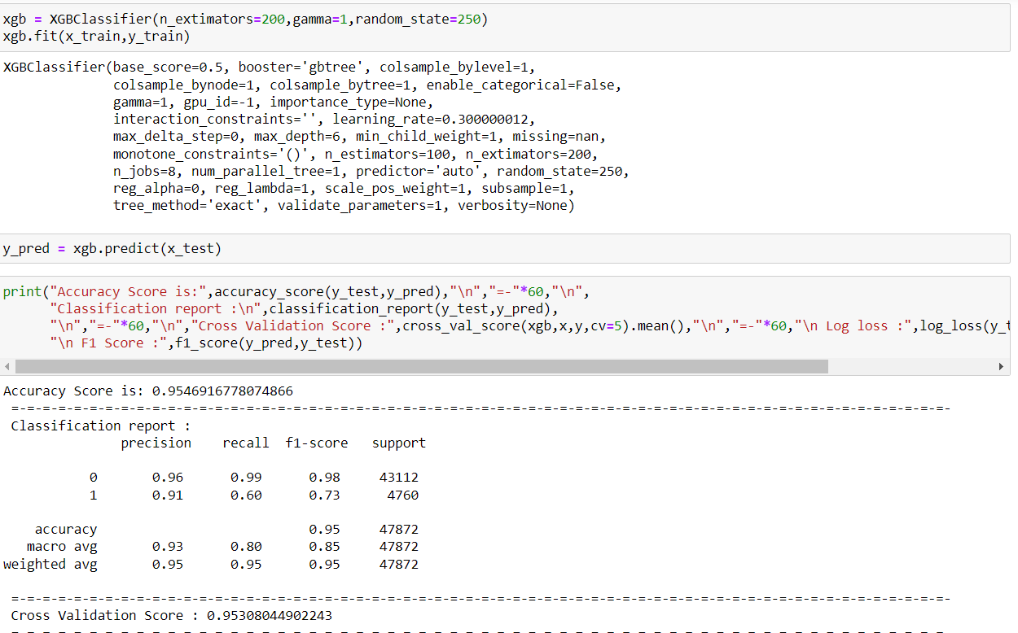
Final Model
XGB Regressor(after hyperparameter tuning)

Slide 19
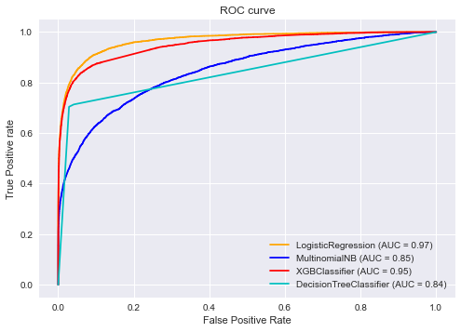
Auc- Roc curve
If we see the Auc-Roc curve we can see that Xgb covers 95% of the region whereas Logistic Regression covers 97% but f1 score of xgb is slightly higher than Logistic Regression. So our final model is xgb.

Slide 20
Conclusion
This dataset is imbalanced so I have select the model on the basis of F1_score.
Detecting and removing malignant comment is very essential for any social media to stop cyberbullying and spread hates.

